Slide 1
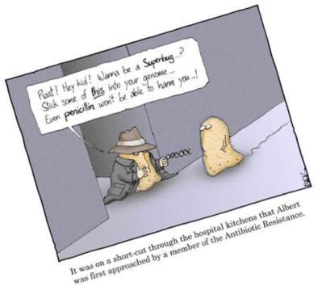
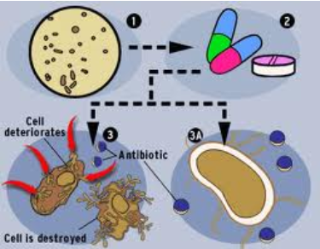
Bacteria
Antibiotics – any substance that will either kill or slow down the growth of bacteria
  1st discovered by Fleming – penicillin
  They specifically stop the bacteria from forming their cell walls

Slide 2


What is bacteria?
Unicellular living organism
Simple cell structure
  No true nucleus
  No membrane bound organelles (ex. Mitochondria & chloroplasts
  Protective cell wall = shape and ability to live in wide range of environments
  Capsule = resistance

Slide 3
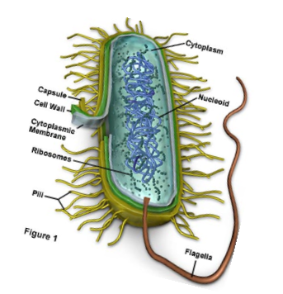
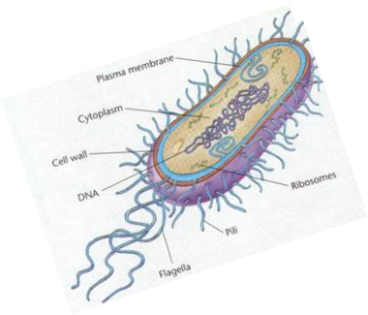
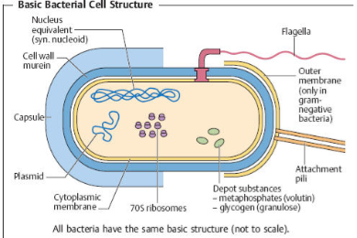
Basic Structure

Slide 4
2 basic types of bacteria
Archaebacteria
Eubacteria
“extreme” habitats
  Oxygen-free
  High salinity
  High acidity
More “hospitable” environments = almost everywhere
Use organic molecules as their E source

Slide 5
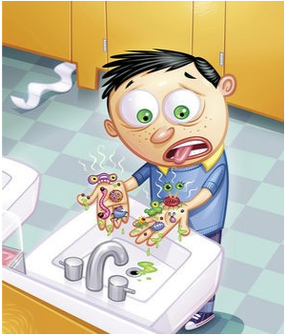
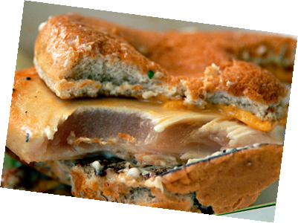
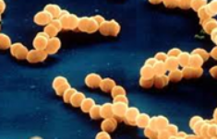
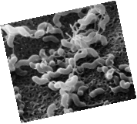
Good vs. Bad
GOOD:
Intestinal:
- Aid in digestion
- Produce vitamins
- Maintain pH of stomach
- Work with our immune system
Skin:
- protect from fungus
Food:
Yogurt
cheese
BAD:
Pathogens:
- tetanus
- pneumonia
- tuberculosis
- streptococcus = strep throat
Food:
- campylobactor – food poisioning
- can cause botulism (paralysis & death)
Campylobactor – raw chicken
Streptococcus

Slide 6
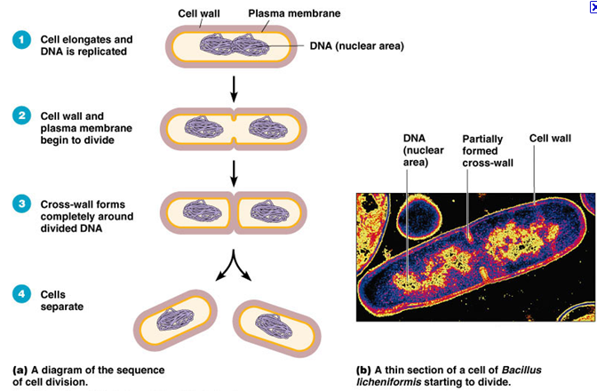
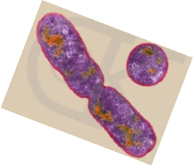
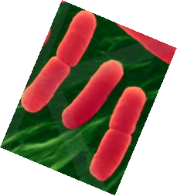
Binary Fission (asexual reproduction)
Binary Fission Animation

Slide 7
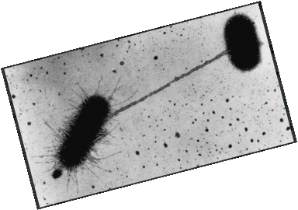
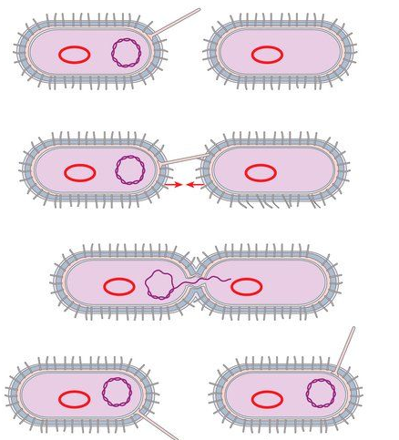
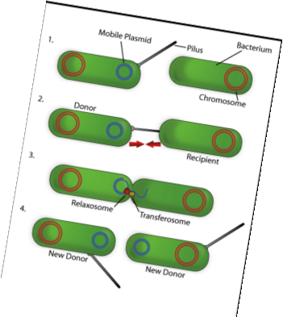
Conjugation (sexual reproduction)
Conjugation Animation

Slide 8
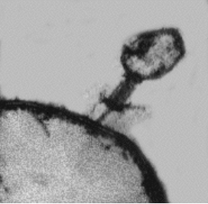
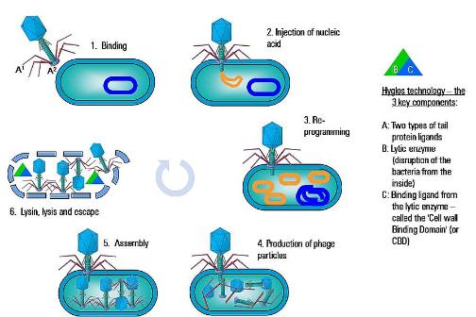

Viruses
What is a bacteriophage?
  a type of virus that infects bacteria cells
  T4 phage is an example that infects E. coli bacteria
bacteriophage
Bacteria
Cell

Slide 9
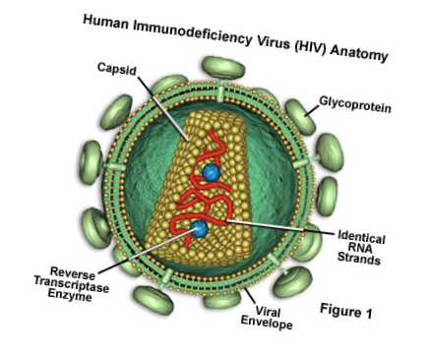
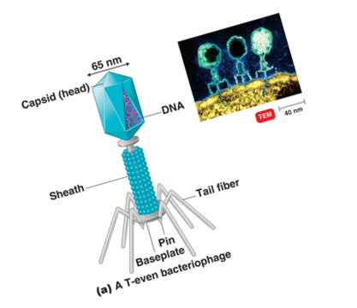
What are viruses?
Non-living substances that can reproduce in a living host cell.
Genetic information enclosed in a protein structure called a capsule

Slide 10
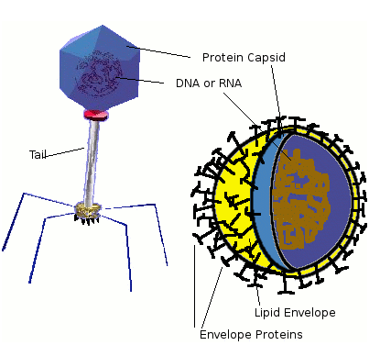
Basic Structure

Slide 11
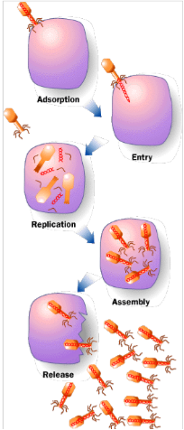
How do they work?
Viruses either enter or inject their DNA/RNA into a host cell.
Viruses use that host cell to replicate themselves.
Once they are done they destroy the host cell

Slide 12
Living or Non-living?
Most scientists consider viruses to be non-living.
  Do not metabolize/use energy
  Do not grow & develop
  Do not adapt to their environment
Can only reproduce by using a living host cell

Slide 13
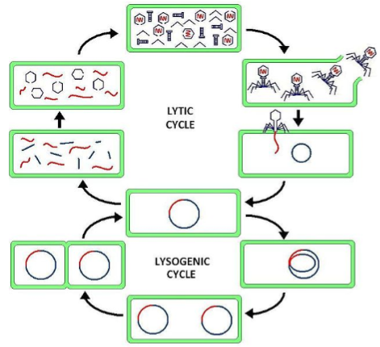
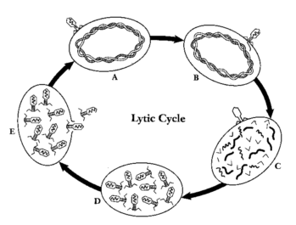
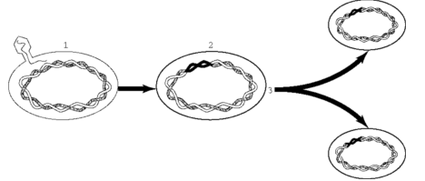
Lytic Cycle
  Virus uses host cell machinery to make new viruses
  Approximately 30 minutes to complete cycle
  Destroys house cell
Lysogenic Cycle
  Does not immediately destroy host cell
  Dormant period
  Finally enters lytic cycle

Slide 14
Bacteriophage vs. Provirus vs. Retrovirus
Bacteriophage is a virus that attacks a bacteria cell
  Example is T4 virus that infects E. coli bacteria
Provirus is the genes of a virus that become part of an organisms DNA (it can be any type of virus)
Retrovirus is a virus that has RNA as its nucleic acid (it can make DNA from it’s RNA).
  Example would be HIV

Slide 15
Sources
http://www.buzzle.com/articles/helpful-and-harmful-types-of-bacteria.html
http://www.visualphotos.com/image/1x6039875/campylobacter_jejuni_bacteria
http://calorielab.com/news/2008/06/23/foodborne-illnesses/
http://microbewiki.kenyon.edu/index.php/Dental_Caries_Prevention_by_Camellia_sinensis
http://science.nayland.school.nz/graemeb/yr11%20work/microbes/bacteria.htm
http://www.emc.maricopa.edu/faculty/farabee/biobk/biobookmito.html
http://www.sciencephoto.com/media/133792/enlarge
http://www.classzone.com/books/hs/ca/sc/bio_07/animated_biology/bio_ch05_0149_ab_fission.html
http://www2.raritanval.edu/departments/Science/full-time/Weber/Microbiology%20Majors/SoftChalkeCoursesubmission/chapter13sub/chapter13sub_print.html
http://water.me.vccs.edu/courses/env108/lesson2_4.htm
http://politically-confused.blogspot.com/2011/03/natural-antibiotics-info.html
http://primos.com.my
http://www.dform.com/projects/t4/virus.html

